Slide 1

Information Percolation Systems on Traffic Management
Modelling and Simulation
M.EIC - Group 3 - 22/23
Marcelo Couto
António Oliveira
Luis Lucas

Slide 2
Index
Problem Formalisation
Motivation & Goals
Methods & Materials
Tools
Models
Operation Policies
Scenarios
Decision Criteria
Demonstration
Results & Analysis
Conclusions

Slide 3
Problem Formalisation
Braess Paradox: the observation that adding one or more roads to a road network can slow down overall traffic flow.
How can information percolation (dissemination) be used to control traffic?
CAVs (Connected Autonomous Vehicles)
GPS and wireless smartphone communication

Slide 4
Motivation & Goals
This project aims to develop a simulation environment capable of testing the impact of information percolation systems in the management of traffic networks and their congestion, specifically their ability to reduce overall travel time and congestion.
Concrete Objectives:
Model the behaviour of traffic evolution with BPR function
Model the typical behaviour for route choice through Descriptive Models
Model a possible new method as an Information Percolation System as a Speculative Model
Define and develop a simulation environment with multiple scenarios
Collect and analyze results regarding the impact of the operation policies in the different scenarios

Slide 5
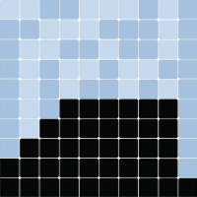


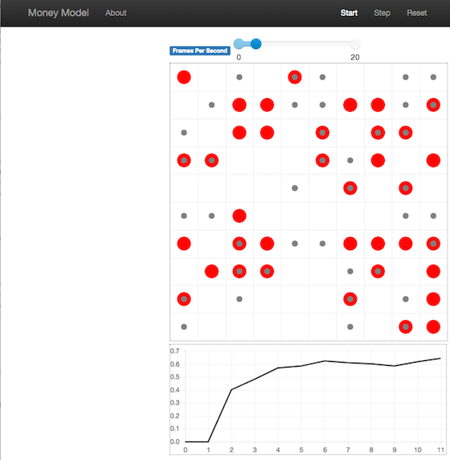
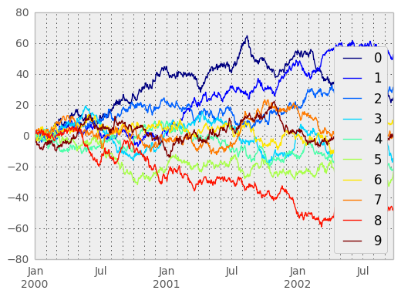
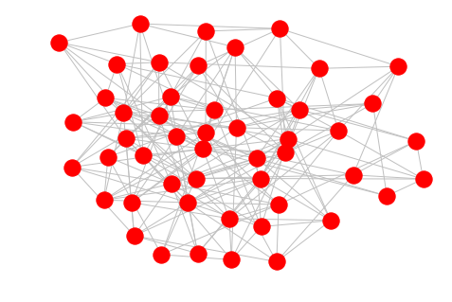

Tools
Mesa: lightweight agent-based simulation library for python
NetworkX: lightweight graph construction library for python
Matplotlib - python library for creation and visualization of plots and graphs

Slide 6
BPR Function
Our project does not require data collection, as the data can be modelled itself. We can simulate the behaviour of a traffic network and model the travel time in accordance to the capacity and current volume of a given route using a BPR (Bureau of Public Roads) function.
Tₐ = T₀ * (1 + ɑ * (V/C)ᵝ)
Tₐ: time for travel
T₀: travel time without traffic
V: volume
C: capacity
The only Data Collection necessary is the one associated with minimally realistic Volume and Capacity values.
ɑ = 0.15
β = 4.0
Tuned
Gore, Arkatkar, Joshi & Antoniou (2023). Modified Bureau of Public Roads Link Function.

Slide 7
Models
Exogenous Variables:
Uncontrollable
Traffic Network Configuration
Vehicle Arrival Rate
GPS Usage Ratio
Controllable
Information Percolation Method - Vehicle Route Decision Strategy
Endogenous Variables:
Average Travel Efficiency at 200
Average Travel Time at 200
Max Volume to Capacity Ratio at 200
Steps until 200
Other details:
Discrete simulation: one time step is roughly equivalent to 1 minute
Agent-based: vehicles are agents

Slide 8
Models
Descriptive Model 1’s Operation Policy (Base): (no information percolation) has the vehicles go for the shortest route to the destination, as if the driver knew the shortest path or he was using a map or gps.
Descriptive Model 2’s Operation Policy (GPS): has the drivers choose the route with the lowest travel time according to the BPR function executed a few steps behind a percentage of the time, emulating a Google Maps system that estimates travel time with a certain delay.
Speculative Model’s Operation Policy (CAV): has the vehicles always go for the route with the lowest travel time according to the BPR in that moment, as if they were Connected Autonomous Vehicles that knew exactly the volume on each route, as they are in sync.

Slide 9
Scenarios
The scenarios are the result of the permutation of the following variables: Information Percolation Scheme, Network Structure and Vehicle Arrival Rate.
Traffic Networks
Traffic Volume
15
20
35
Operation Policy
Base
GPS
CAV
100, 14
100, 12
50, 5
150, 16
50, 12
50, 10
50, 10
50, 10
50, 15
50, 7
50, 10
200, 5
100, 7
150, 16
50, 5
50, 8
50, 10
50, 5
200, 10
200, 5
150, 5
150, 10
200, 5
Large
Medium

Slide 10
Decision Criteria and Performance
Performance Metrics:
Average Travel Time at 200: average time taken by a vehicle to cover the (when the 200th vehicle finishes the path)
Average Travel Efficiency at 200 (ATE200): ratio between the shortest time necessary for completion of a path without traffic with the average travel time (when the 200th vehicle finishes the path)
Max Volume to Capacity Ratio at 200: illustrates the maximum congestion of any route in the network (when the 200th vehicle finishes the path)
Steps until 200: number of simulation steps (mins) until 200 vehicles complete the path

Slide 11
Decision Criteria and Performance
Performance Indicator: Average Travel Efficiency at 200 > 0.4
Decision Criteria:
If the CAV Model presents an improvement in ATE200 of more than 0.1 compared to the Descriptive Models, then the adoption of CAVs should be taken as a serious solution for traffic congestion problems
If a Model fulfills the performance indicator, its usage is deemed justified by this experiment

Slide 12

Demo

Slide 13
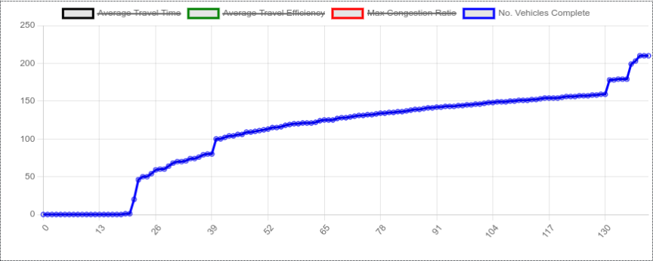
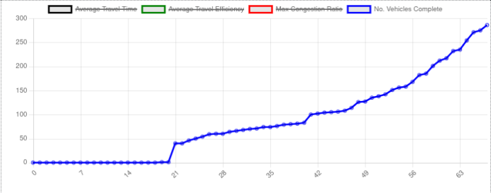
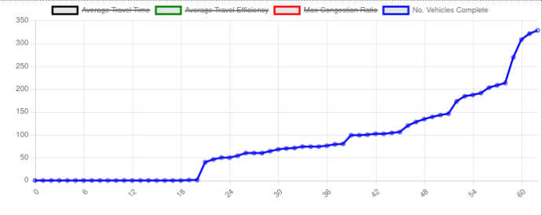
Results & Analysis
Base
No. Vehicles Completed > Steps until 200
CAV
GPS
Base
Base Case performed significantly worse.
CAV was only marginally better than GPS
GPS
CAV

Slide 14
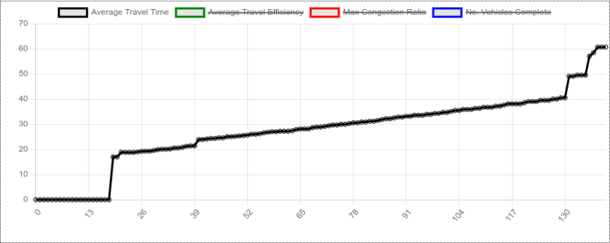
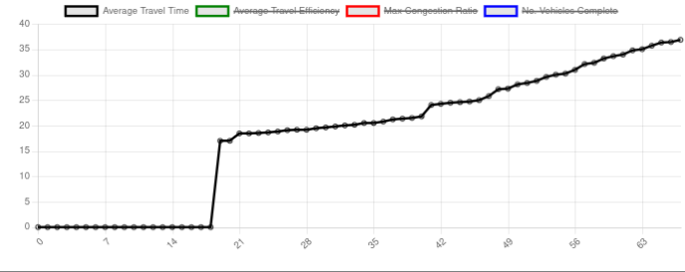
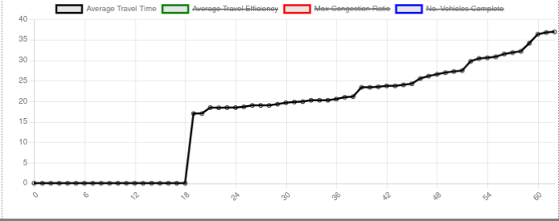
Results & Analysis
Base
Average Travel Time
CAV
GPS
Base
Base Case performed significantly worse
CAV was only marginally better than GPS
GPS
CAV

Slide 15
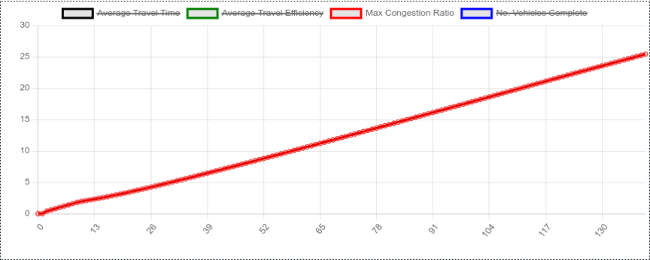
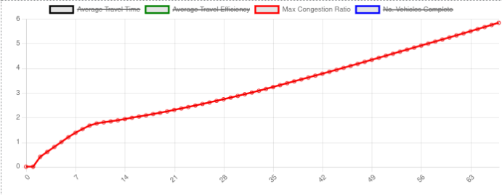
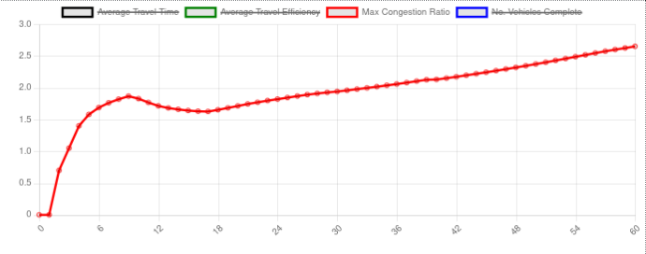
Results & Analysis
Base
Max Congestion Ratio
CAV
GPS
Base
Base Case performed significantly worse
CAV was only marginally better than GPS
GPS
CAV

Slide 16
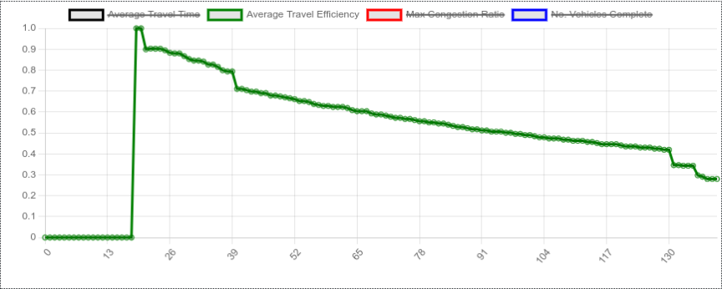
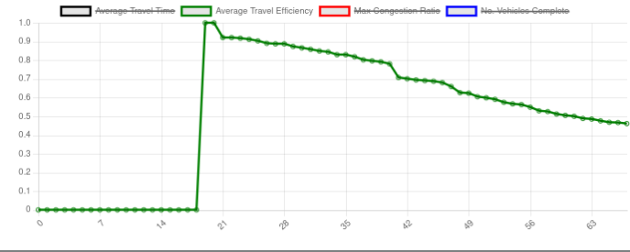
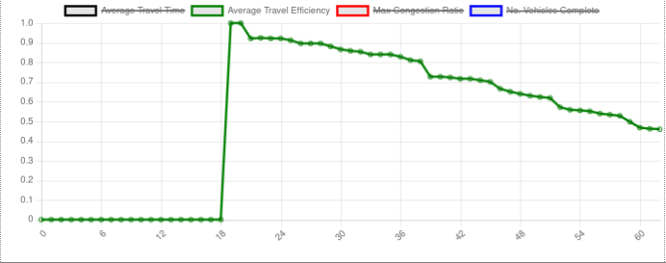
Results & Analysis
Base
Average Travel Efficiency
CAV
GPS
Base
Base Case performed significantly worse
CAV was only marginally better than GPS
Performance Criteria met by GPS and CAV
GPS
CAV

Slide 17
Conclusions
In sum:
both the Descriptive Model 2 (GPS) and the Speculative Model surpassed the performance criteria
Only decision criteria 2. had grounds to be taken, meaning this experiment concludes Google Maps ‘like’ apps can work
Future Work:
Increase validation - improve model fidelity by validating with real world data
Tuning BPR
More accurate data on Google Maps usage
More accurate data on capacity of routes and realistic traffic networks

Slide 18
Questions?

